Slide 1
Polar bonds ordering and negative thermal expansion
Yuriy Poplavko
National Technical University of Ukraine "Igor Sikorsky Kyiv Polytechnic Institute"

Slide 2
Abstract
Thermal expansion coefficient α reflects peculiarities of inter-atomic bonds in crystals, and it usually increases by cubic law with temperature rise: α ~ T3.
Negative value of α(T), seen mostly in polar crystals in a certain temperature interval, is typical for crystals characterizing by the configurational entropy, which as opposed to the vibrational entropy, increases as pressure grows.
Negative α(T) corresponds to self-ordering of polar bonds, and is seen not only in the piezoelectrics, but also in some semiconductors (like Si) due to virtual hexagonal polar phase.
ISAF-ISIF-PFM 2021
Notes:
dgdf

Slide 3
Lindemann relation and Grüneisen law
Coefficient of thermal expansion α = (1/V)⋅(∂V/∂T)p;
α ~ 1/Тmelt (melting temperature); Тmelt ~ θD2 (Lindemann)
α ~ θD–2 θD - Debye temperature, so α is expected to be positive
Below θD coefficient α(T) is proportional to specific heat:
α(T) ~ C(T) ~ T3.
Increase of α(T) corresponds to heat capacity C (Grüneisen) so thermal expansion of solid dielectrics:
α = γ⋅CV/3K,
K - modulus of bulk elasticity (all-round compression)
γ - Grüneisen constant characterising interatomic forces
ISAF-ISIF-PFM 2021

Slide 4
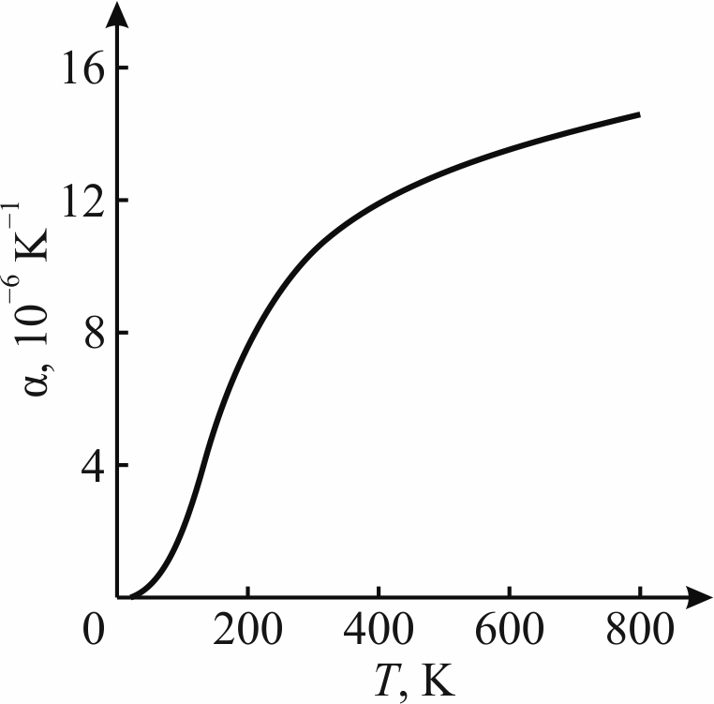
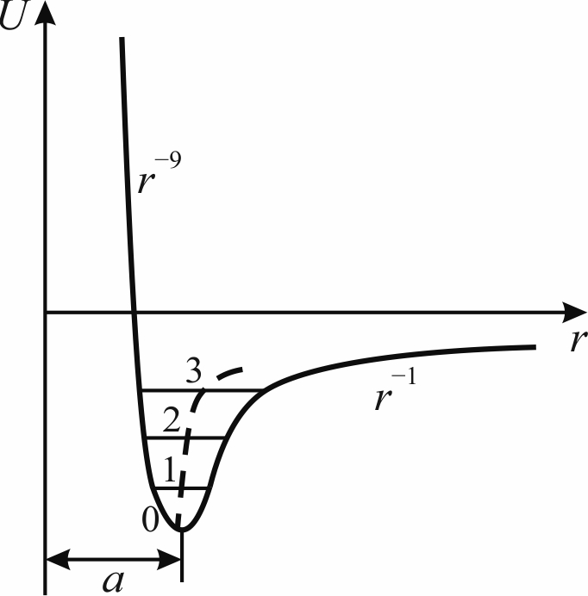
Typical thermal expansion in crystals
(for examle in MgO)
ISAF-ISIF-PFM 2021

Slide 5
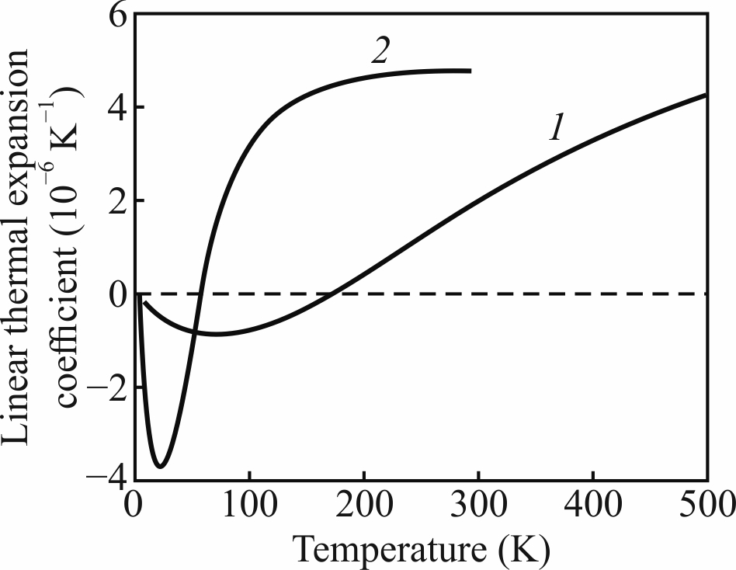
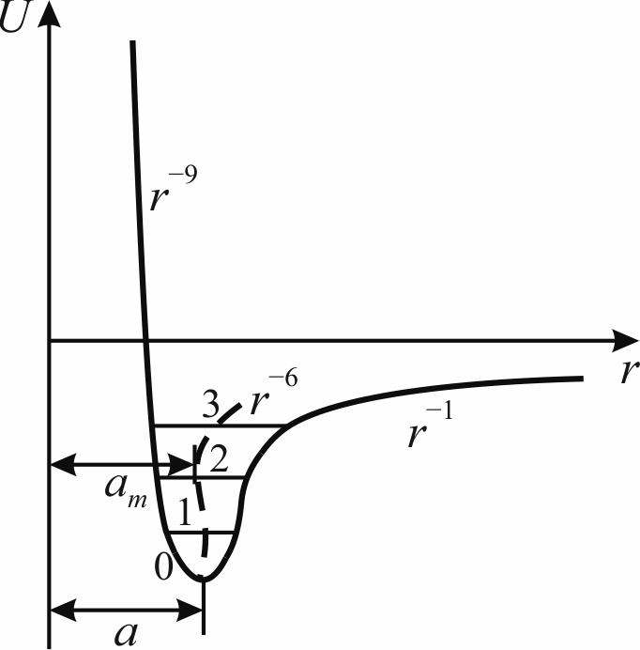
Negative α(T) in ZnO (1) and in HgTe (2) crystals
ISAF-ISIF-PFM 2021

Slide 6
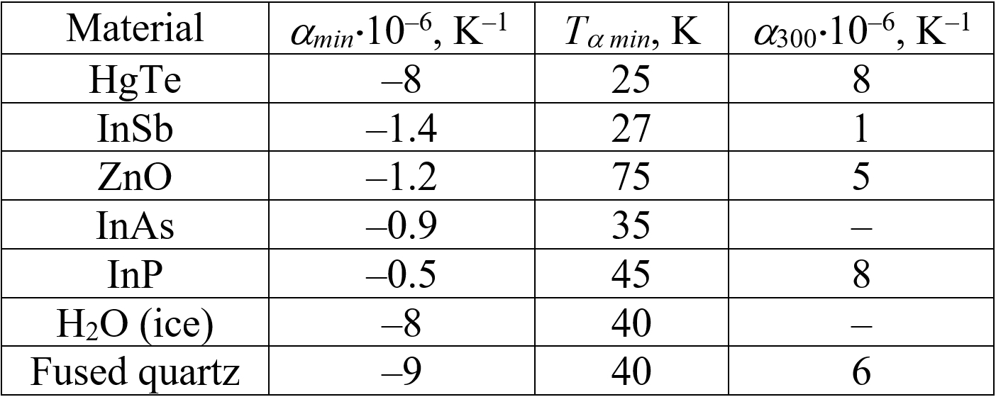
Minimal value of thermal expansion coefficient (αmin) and its temperature Tα min
ISAF-ISIF-PFM 2021

Slide 7
Negative α, volumetric compresability K and configurational entropy
The relationship α ⇔ K means that thermal action and homogeneous compression are scalar impacts on crystal, so in both cases reflects peculiarity of atomic bonds structure. Other methods violate the symmetry of response, which is the sum of two symmetries: action and crystal (Curie principle).
Positive α > 0 thermodynamically connected with the case when the entropy S decreases with increase of pressure.
Negative α < 0 seen in polar crystals corresponds to peculiar case, when entropy increases with pressure rise (possible only for configurational entropy).
ISAF-ISIF-PFM 2021

Slide 8
Thermodynamic explanation by Gibbs potencial
Gibbs potential G = U + pV – TS corresponds to the equilibrium of the thermodynamic system at fixed temperature, pressure and number of particles.
In differential form: dG = – SdT + Vdp, so thermal expansion coefficient α = (∂V/∂T)p/V can be expressed as:
α = (1/V){∂2G/(∂T∂p)}.
By the replacing variables, one can get final result:
α = – (1/V){∂S/∂p}.
In almost all solids α > 0, because repulsive inter-atomic forces in crystal lattice act at short-range distance, while attraction forces act at long-range distance. Obtained expression means that usually the entropy is lesser with greater pressure.
ISAF-ISIF-PFM 2021

Slide 9
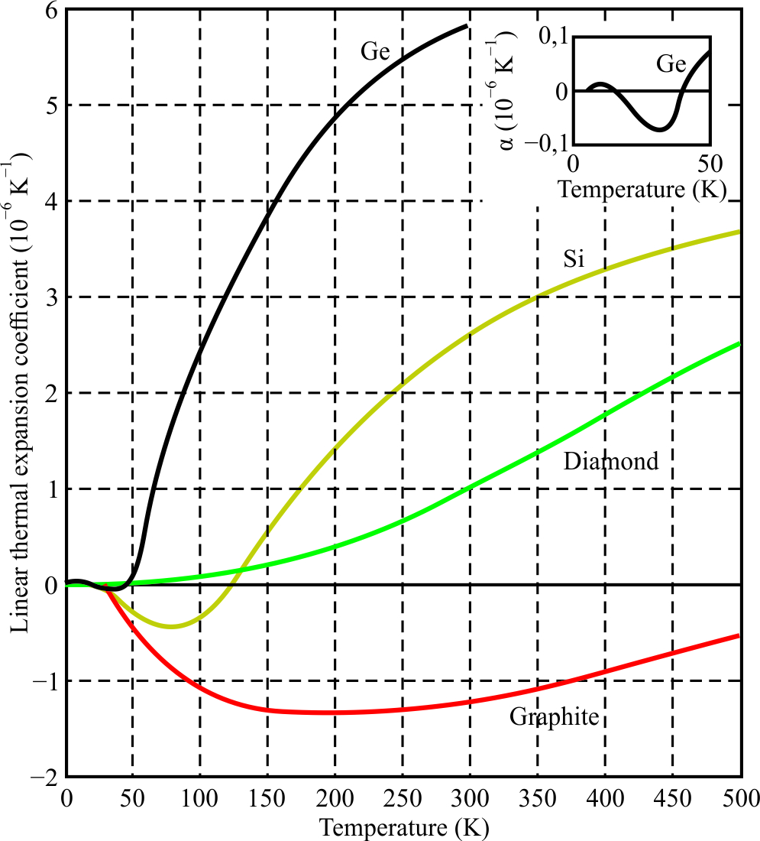
Negative thermal expansion in semiconductors
ISAF-ISIF-PFM 2021

Slide 10
Fluctuating hexagonal structural motive
How suspect natural polarity in atomic semiconductors consisting of only one chemical element and possessing?
What ordering is possible in crystals of diamond type?
(1) The double covalent bonds can mix with single bonds: this assumption is due to hexagonal diamond existence (initially discovered in meteorites but later synthesized).
(2) Hexagonal structural motive (seen in diamond), probably, is weakly fluctuating in Si and Ge, but is fully implemented in graphite and graphene characterized by negative α(T)
ISAF-ISIF-PFM 2021

Slide 11
Conclusions
Thermal expansion coefficient of polar crystals at low temperature twice changes its sign, forming region of α(T) negative value.
Broad minimum of α means that crystal occupies larger volume: the stronger interatomic bonds, the less thermal expansion, down to its negative value.
Negative value of α(T) corresponds to particular case when entropy increases with pressure rise (typical for configurational entropy).
ISAF-ISIF-PFM 2021

Slide 12
Thanks for attention!
ISAF-ISIF-PFM 2021

